Slide 1

Industry Project Presentation on “Real Time Defect Detection And Classification Using AI Techniques”
By
Group ID: G20
Jainam Shah (18162121033)
Het Mehta (18162121008)
Krutik Shah (18162121035)
Jaspreet Singh Pal (18162121014)
Under the guidance of
Mr. Yagnesh Vyas & Mr. Punit Lalwani
Institute of Computer Technology, Ganpat University
Date: 2nd May 2022

Slide 2
Table of Contents
Introduction
Objectives
Related Background
Expected Outcome
Tools & Technology
TimeLine Charts with Milestones
Process Model & Data Flow Diagram
Implementation Details
Results
Conclusion And Future Work
References

Slide 3
Introduction
In today’s highly competitive global market, winning requires shipping a product with near perfect quality, hence the ability to accurately detect defected products while maintaining high production rates is a core competency that enterprises should possess.

Slide 4
Objectives
The objectives of this proposed project are as follows: -
Gather data from the user which consists of perfect dimensions of an object in the form of an image.
Compare it with images of the object to check for any defects.
Train an Artificial Intelligence model that can detect defective products.
Classify the type of defect from the picture captured.

Slide 5
Related Background
Defects are inevitable in manufacturing like undesired holes, scratches, abrasions and many more.
Defects may originate from design failures, faulty production equipment or unfavorable working conditions.
Defected products hampers with the cost of production and also affects customer satisfaction, hence it is necessary to avoid and detect the faulty pieces.
With the advancement of technology, we can now train Machine Learning models to learn on their own to identify defected products.
Autonomous defect detection systems deliver improved efficiency and accuracy. These systems can be used for every manufacturing industry.

Slide 6
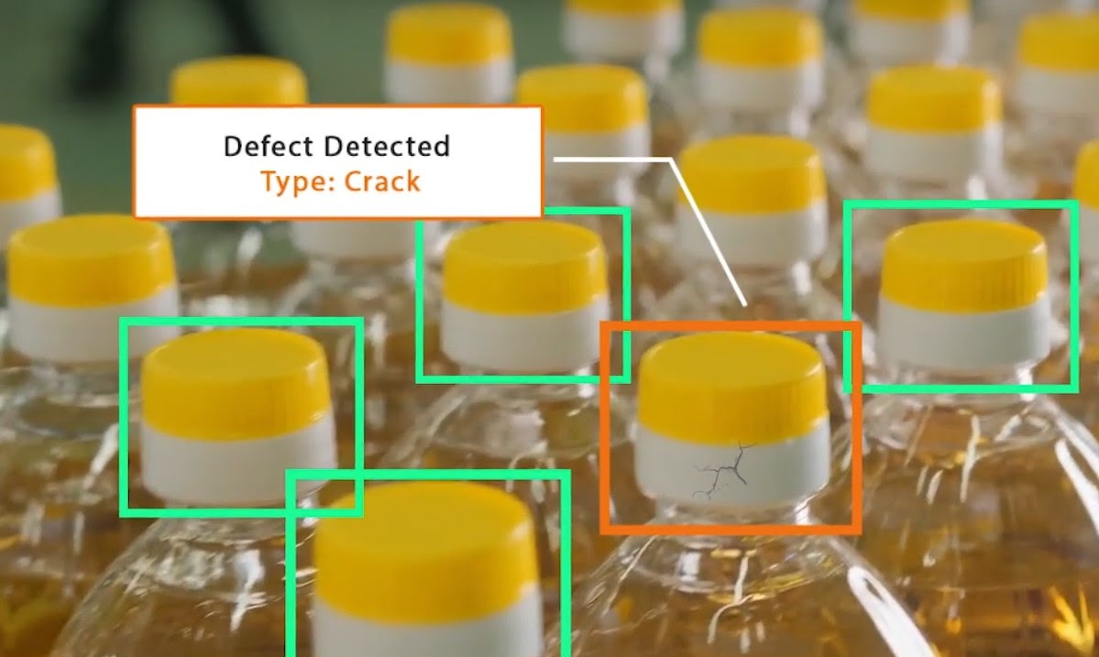

Expected Outcome

Slide 7









Tools And Technologies

Slide 8
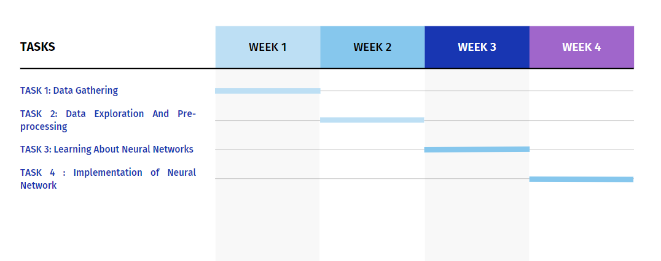
Timeline Chart With Milestones (1st Phase)

Slide 9
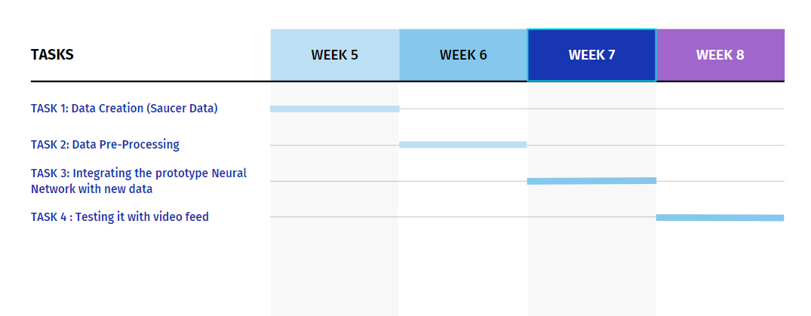
Timeline Charts with Milestones (2nd Phase)

Slide 10
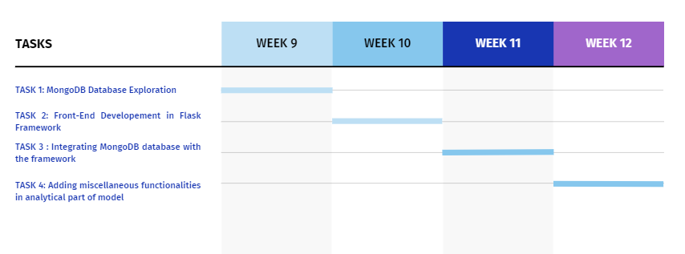
Timeline Charts with Milestones (3rd Phase)

Slide 11
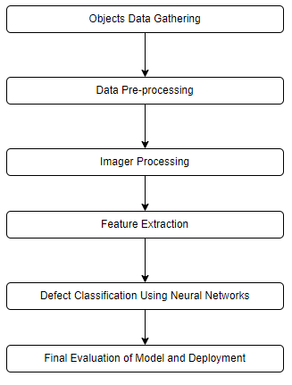
Process Model

Slide 12
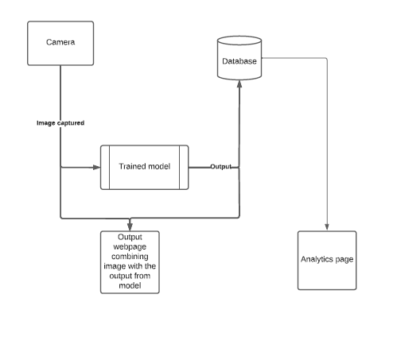
Data Flow Diagram

Slide 13
Implementation Details
In the first phase of the project data was gathered related to different products and a prototype model was built in which CNN algorithm was utilized to detect defects in images.
In the second phase of project a defect detection and classification model has been developed which detects and classifies images of a saucer, it has three categories for output, Normal, Defect 1 and Defect 2.
In the third phase of project a web-application has been developed for the defect detection and classification model developed in earlier phase, it classifies images of a saucer in three categories for output as Normal Saucer, Plain saucer and chipped saucer.

Slide 14
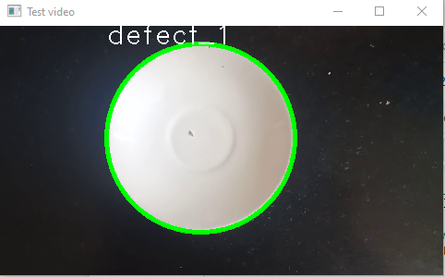
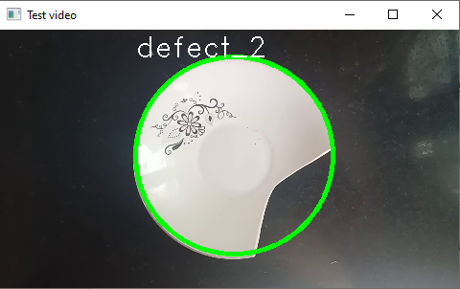
Results

Slide 15
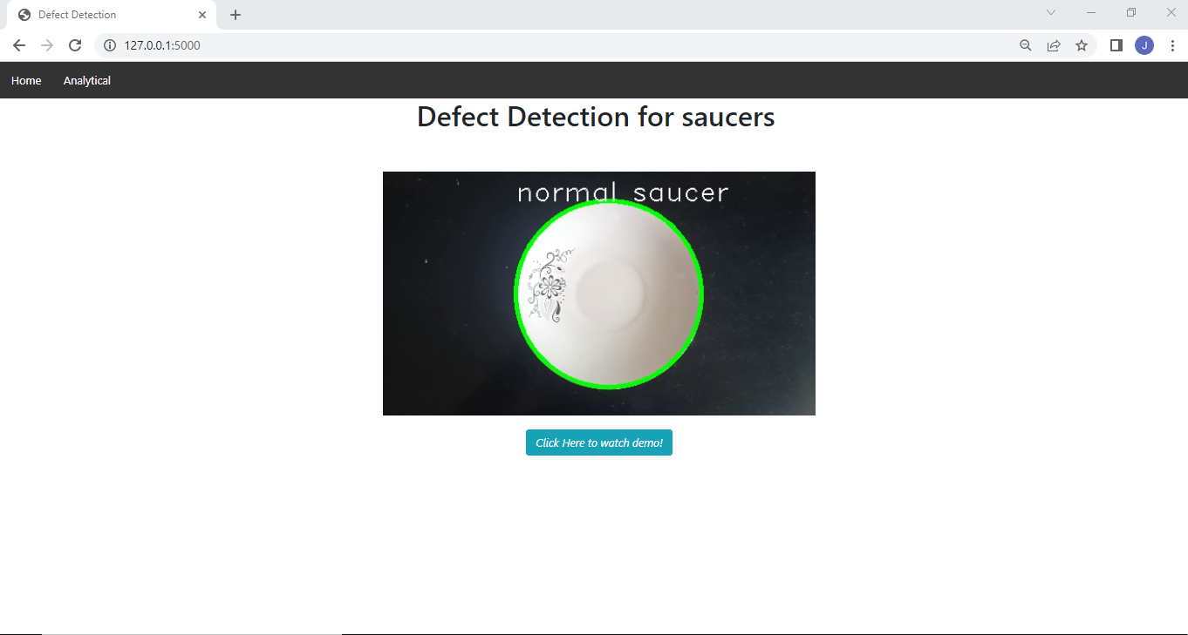
Results

Slide 16
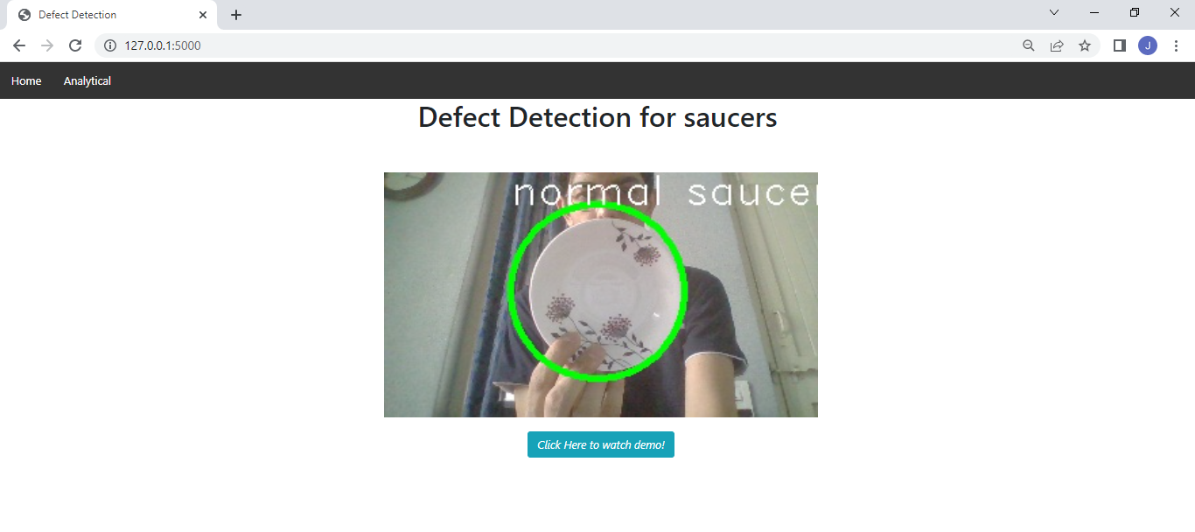
Results

Slide 17
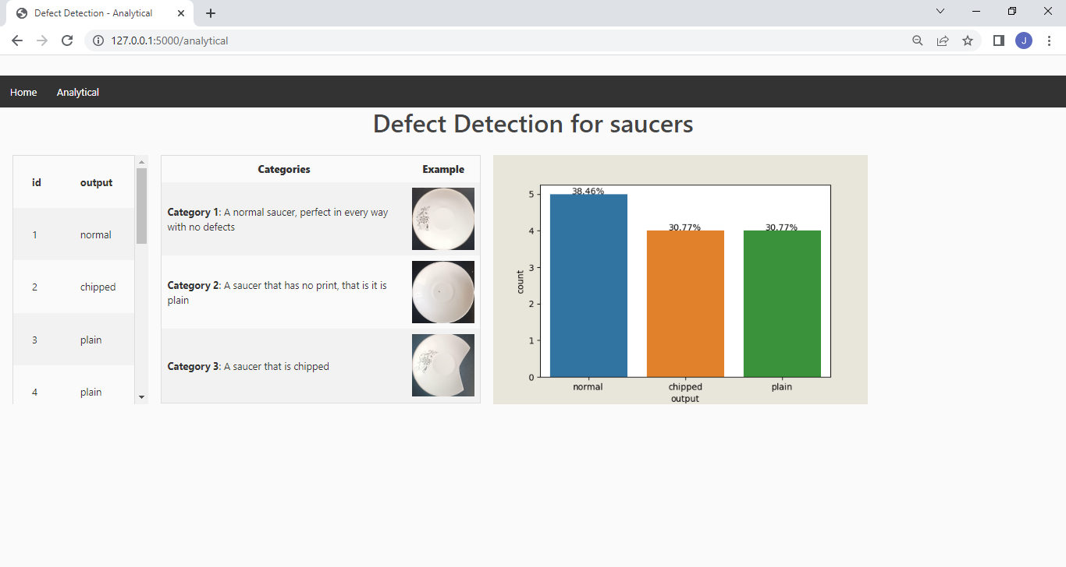
Results

Slide 18
Conclusion
In conclusion, a Sequential Neural Network is successfully built for pistons dataset and saucer dataset and it is achieving accuracy nearly to 100% for training, validation and testing data. Furthermore, saucer dataset is also created and tested perfectly for the built model. Defect Detection in saucers is identified correctly and giving promising results. General guidelines for developing machine learning model have been identified based on defect classification paradigm. The above developed model after being deployed on an online web application shows meaningful information about the defects detected and still displays a lot of potential to evolve and provide further insights based on data provided.

Slide 19
Future Work
Till now we have developed the working model of our project by applying deep learning algorithm. Furthermore, we intend to develop a front-end web application for defect detection and pass live feed of objects in order to detect defects and classify them accordingly. In this project a database has been developed from the scratch and a neural network has been trained on the aforementioned database, then the model is saved so that anyone can use it easily without wasting any time to retrain the model every time we run the program. After that, a front-end application has been developed using flask through workers can look at the output and pick out the defective pieces from the production line. For future work, we can extend the program to automatically select and remove the defective pieces from the production line, integrating the purely software with IOT based production line.

Slide 20
References
https://www.analyticsvidhya.com/blog/2021/06/image-classification-using-convolutional-neural-network-with-python/
https://www.tensorflow.org/
https://www.kaggle.com/satishpaladi11/mechanic-component-images-normal-defected
https://www.ndt.net/article/wcndt2004/pdf/in-process_ndt-nde/788_popat.pdf
https://www.analyticsvidhya.com/blog/2021/06/image-classification-using-convolutional-neural-network-with-python/
https://mobidev.biz/blog/ai-visual-inspection-deep-learning-computer-vision-defect-detection
Using Deep Learning to Detect Defects in Manufacturing: A Comprehensive Survey and Current Challenges By Jing Yang, Shaobo Li, Zheng Wang ,Hao Dong ,Jun Wang and Shihao Tang
https://matplotlib.org/stable/index.html
https://flask.palletsprojects.com/en/2.1.x/
Defect Detection and Classification Using Machine Learning Classifier By Mitesh Popat and S.V. Barai, Indian Institute of Technology, Kharagpur

Slide 21
THANK YOU !!

